Slide 1

Implementation of 5G Stand Alone Network
Utilizing Open5gs and UERANSIM:
Team members:
Padmini Manjunatha 1427336
Kushal Prakash 1429800
Karthik Kothamangala Sreenath 1438341
Madhushree Manjunatha Lakshmidevi 1445185

Slide 2
Contents
Project Roadmap
Introduction to 5G Standalone Architecture
5G Evolution
Importance and Key features of 5G technologies
Key components and features of 5G
Network Slicing
Open5gs and UERANSIM
Network Architecture
Practical Demonstration of the services used
Conclusion

Slide 3
Project Roadmap
Sprint 1: Setup and Resource Collection
Sprint 2: Environment Setup and Initial Testing
Sprint 3: Core Installation and Configuration
Sprint 4: Network Slicing and Architecture Design
Sprint 5: Service Integration and Documentation
Sprint 6: Final Testing and Project Presentation

Slide 4

Introduction
The 5G Standalone Standalone architecture is a next-generation network framework designed exclusively for 5G. Unlike the Non-Standalone (NSA) architecture, which relies on existing 4G LTE networks, the SA architecture operates independently, leveraging a fully 5G core network. This independence allows it to fully utilize 5G's capabilities, including enhanced speeds, reduced latency, and increased capacity.

Slide 5
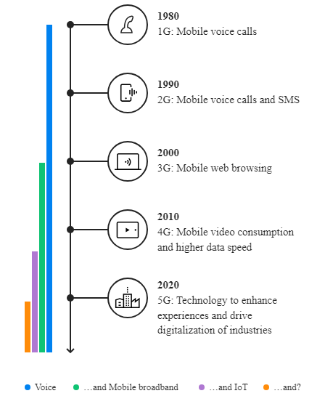
5G Evolution:
The 1G era was defined by briefcase-sized phones and short conversations between a relatively small number of professional people.
In the lead up to 2G, the demand for mobile services grew and never slowed down.
Phones that could fit in your pocket, SMS and mobile internet access were hallmarks of the 3G world.
Thanks to 4G, we have smartphones, app stores and YouTube.
Now, 5G is completely reshaping both our professional and personal lives by enabling new use cases like connective vehicles, Augmented Reality and enhanced video and gaming.

Slide 6
Importance of 5G technology
Increased Data Speed
Reduced Latency
Greater Connectivity
Network Slicing
Enabling New Technologies
Economic Impact
Enhanced Mobile Broadband (eMBB)

Slide 7
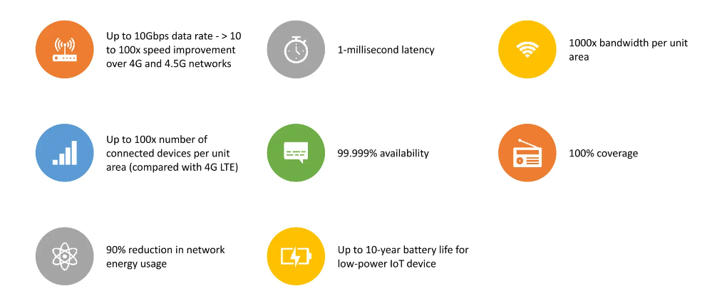
Key features of 5G technology

Slide 8
Key components and features of the 5G
gNodeB (gNB)
Core Network (5G)
User Equipment (UE)
Network Functions (NFs)
Interfaces
Network Slicing

Slide 9

gNodeB (gNB)
The gNodeB is a critical component in 5G networks, acting as the next-generation base station that connects mobile devices to the network. It supports Massive MIMO technology, enhancing network capacity and efficiency. gNodeB is vital for delivering 5G's key features, such as high-speed broadband and ultra-reliable, low-latency communications. It enables flexible deployment across various environments, from urban to rural, through macro, micro, and pico cells. Additionally, gNodeB is essential for implementing network slicing, allowing for customized network segments tailored to specific applications or services.

Slide 10

User equipment
User Equipment (UE) encompasses all devices utilized by end-users to access mobile networks, including smartphones, tablets, and IoT devices, especially in the context of 5G. These devices support the advanced capabilities of 5G, such as enhanced data rates, low latency, and increased connectivity options. UEs are crucial for leveraging 5G's potential, facilitating a wide range of applications from streaming to smart cities. They are designed to operate across various frequencies, including mmWave, ensuring wide coverage and high-speed connectivity. The development of UE continues to evolve, focusing on improving performance, energy efficiency, and security to meet the growing demands of 5G networks.

Slide 11
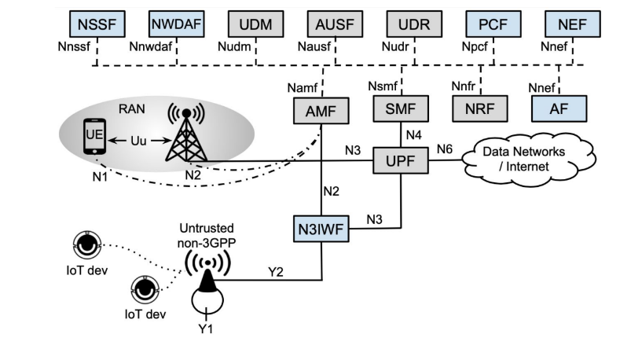
Network functions
Key network functions within the 5G Architecture:
AMF
SMF
UPF
PCF
NSSF
NEF
AUSF
UDM
UDR

Slide 12
Network functions
Access and Mobility Management Function (AMF): Manages all aspects of mobility and session management in conjunction with the Session Management Function (SMF). It handles registration, deregistration, and tracking area updates.
Session Management Function (SMF): Responsible for session establishment, modification, and release. It also selects and manages the User Plane Function (UPF).

Slide 13
Network functions
3. User Plane Function (UPF): Handles packet routing and forwarding, enabling high-speed data transfer and connectivity between the user equipment (UE) and data networks.
4. Policy Control Function (PCF): Provides policy rules to control plane functions, ensuring that data flow and network resources adhere to the policies of the network operator.

Slide 14
Network functions
5. Network Slice Selection Function (NSSF): Manages network slice instances and selects the appropriate slice for each user or device, based on the service requirements.
6. Network Exposure Function (NEF): Exposes the capabilities of the 5G network to external entities, facilitating the development of third-party services and applications.
7. Authentication Server Function (AUSF): Handles user authentication, ensuring secure access to the network.

Slide 15
Network functions
8. Unified Data Management (UDM): The Unified Data Management is a crucial element in the 5G network architecture responsible for managing subscriber-related data. It centralizes and securely stores essential information about users, including authentication credentials, subscription details, and service profiles. The UDM plays a vital role in authenticating users and authorizing their access to network resources, ensuring the security and integrity of the 5G network.
9. Unified Data Repository (UDR): The Unified Data Repository is a critical component within the 5G network architecture, dedicated to storing and managing user data. Specifically, the UDR focuses on handling dynamic user-related data, such as session-specific information, usage statistics, and contextual data relevant to ongoing connections.

Slide 16
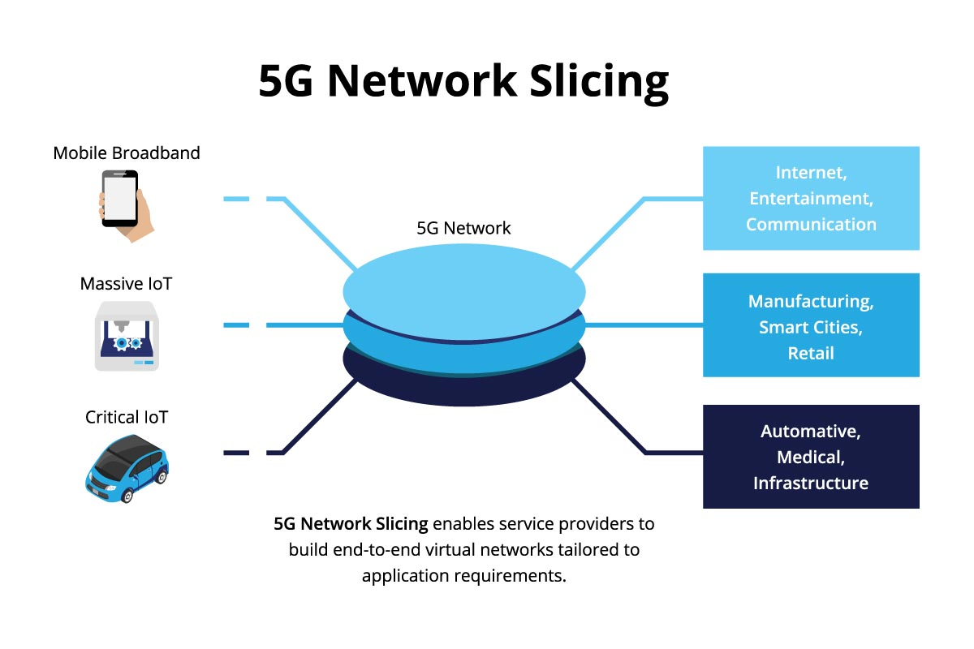
Network Slicing
What is Network slicing?
Network slicing is a form of network virtualization that allows for the creation of multiple distinct, logical networks, each optimized for a specific type of service or customer requirement, over a common physical infrastructure.

Slide 17

Overview of Open5gs
Open-Source Framework: Open5GS is a pioneering open-source project aimed at implementing core network functions for 5G and 4G (LTE) networks.
Facilitating 5G R&D: Provides a comprehensive framework for deploying a fully operational core network, crucial for the research, development, and testing of 5G technologies.
Enabling Flexibility: Acts as a flexible and adaptable core network solution pivotal for the deployment of 5G Standalone (SA) architecture.
Scalability: Designed for scalability, it supports various network sizes, from small experimental setups to large, complex environments.

Slide 18

Overview of UERANSIM
Simulation Tool: UERANSIM is a powerful open-source simulator for 5G networks, specifically designed to emulate the user equipment (UE) and the gNodeB (gNB) components.
5G Network Support: Plays a crucial role in the testing and development of 5G Standalone networks by providing a realistic and flexible simulation environment.

Slide 19
Integration of Open5GS and UERANSIM within the Network
Requirements to integrate Open5GS and UERANSIM:
A Linux-based system (Ubuntu recommended).
Necessary dependencies and libraries for both Open5GS and UERANSIM.
Basic understanding of networking and Linux system administration.
The integration involves starting Open5GS services, followed by launching UERANSIM instances. Upon successful configuration, UERANSIM's UE and gNB should connect to the Open5GS core, enabling simulated 5G network interactions.

Slide 20
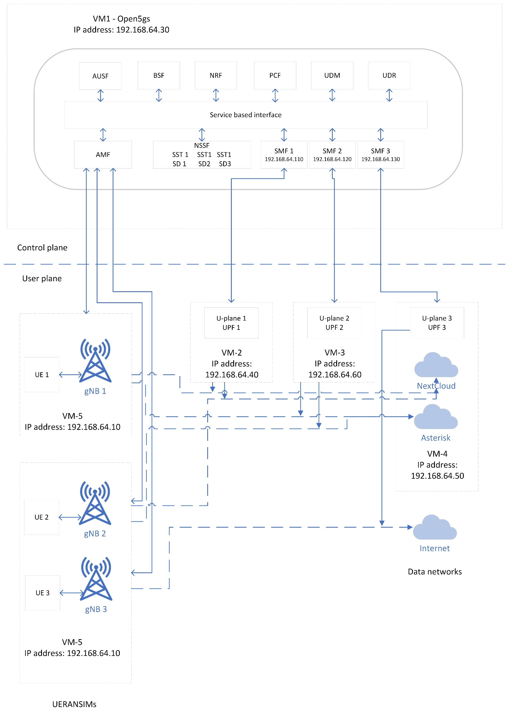
Network Architecture

Slide 21
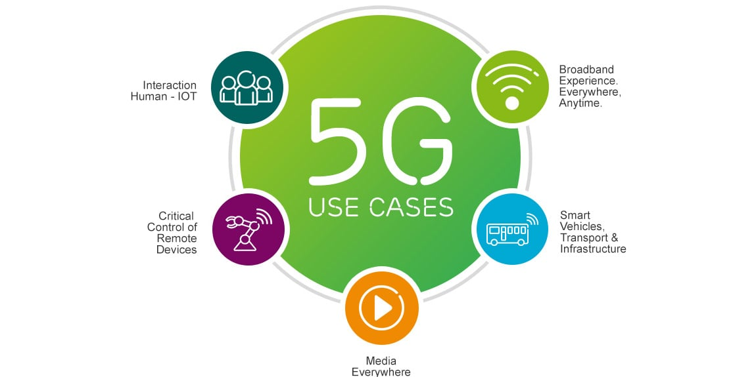
Services:
Voice over Internet Protocol (VoIP)
File sharing (Next cloud)
Video streaming
Internet

Slide 22

VoIP (Voice over Internet Protocol)
This is a technology that allows voice communication and multimedia sessions over Internet Protocol (IP) networks, such as the internet or other packet-switched networks.
VoIP services are expected to improve significantly due to the enhanced capabilities of 5G networks
Higher Bandwidth
Lower Latency
Increased Connectivity
Improved Mobility

Slide 23
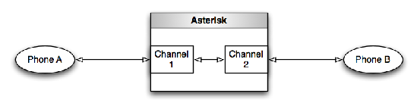
Asterisk and Twinkle
Asterisk is a free, open-source software that acts as a PBX system. It enables you to set up your own VoIP server, supporting various VoIP protocols, including SIP, MGCP, and IAX, among others.
Twinkle is a softphone for making VoIP calls using the SIP protocol. It's designed for Linux and offers a user-friendly interface to manage voice calls over the internet.

Slide 24
VoIP - Demo

Slide 25

File sharing – Next cloud
Nextcloud is a versatile open-source file sharing and collaboration platform that is well-suited to be part of a 5G network infrastructure, leveraging the enhanced capabilities of 5G to offer users a seamless file-sharing experience.

Slide 26
Next cloud - Demo

Slide 27
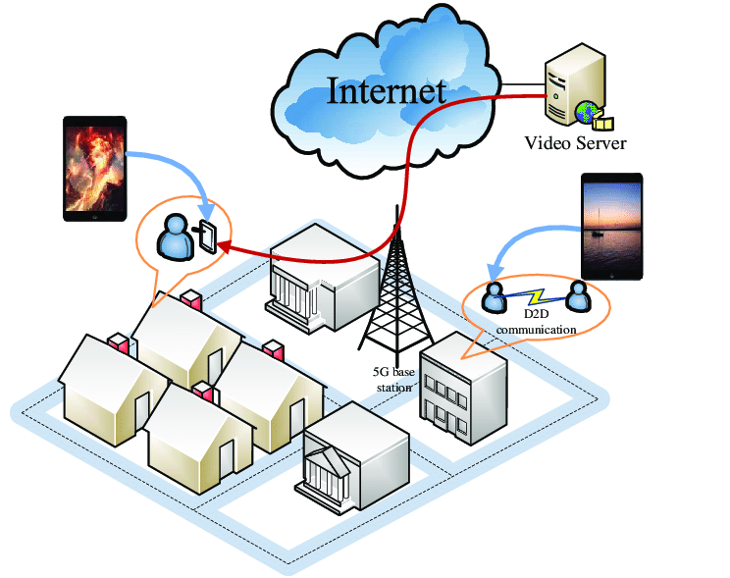
Video streaming
Video streaming services in 5G networks represent a significant leap forward from previous generations, offering unprecedented improvements in speed, efficiency, and user experience.

Slide 28
Video Streaming - Demo

Slide 29

Internet Service
Using the internet on a 5G network enables unprecedented high-speed access and seamless connectivity, enhancing digital communication and internet usage in modern, connected societies across various devices.

Slide 30
Internet - Demo

Slide 31

CONCLUSION
The project showcases the transformative potential of 5G in enhancing VoIP, file sharing, and video streaming services, using advanced platforms and network slicing for optimized performance and scalability. This highlights 5G's role in revolutionizing digital communication and data sharing.

Slide 32

Thank You

